Slide 1
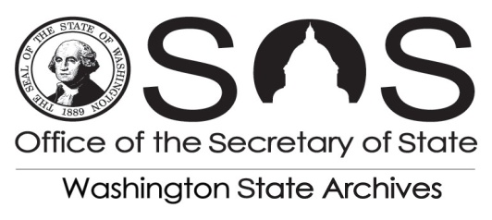
Records Management 101 What to do and how to do it!
Presented by: Michael S. Saunders, Regional Archivist
Phone: 425-564-3950
Fax: 425-564-3945
mike.saunders@sos.wa.gov

Slide 2
Local Government Records Retention Schedules
Focus on key concepts and terms
http://www.sos.wa.gov/archives/RecordsManagement/records_local.aspx

Slide 3
Points of Emphasis
Legal Requirements
Records Disposition Authority

Slide 4
Other Key Concepts:
Archival Preservation
Identify Your Records Series
Public Disclosure
State Archives Services and Support

Slide 5
Key Concept: Legal Requirements
RCW 40.14 - Public Records Act http://apps.leg.wa.gov/rcw/default.aspx?cite=40.14
RCW 40.10 - Essential Records Protection http://apps.leg.wa.gov/rcw/default.aspx?cite=40.10
RCW 40.16 - Illegal Destruction of Public Records http://apps.leg.wa.gov/rcw/default.aspx?cite=40.16
RCW 40.20 - Admissibility of Records Reproductions http://apps.leg.wa.gov/rcw/default.aspx?cite=40.20
RCW 42.56 - Public Disclosure http://apps.leg.wa.gov/rcw/default.aspx?cite=42.56
RCW 36.22.175 - Services to Local Government http://apps.leg.wa.gov/rcw/default.aspx?cite=36.22.175

Slide 6
Open Government Training Act
RCW 42.56.150 Training — Local elected and statewide elected officials.
Each local elected official and statewide elected official, and each person appointed to fill a vacancy in a local or statewide office, must complete a training course regarding the provisions of this chapter, and also chapter 40.14 RCW for records retention.
Within 90 days of assuming office.

Slide 7
Open Government Training Act
RCW 42.56.152 Training — Public records officers.
Public records officers designated under RCW 42.56.580 and records officers designated under RCW 40.14.040 must complete a training course regarding the provisions of this chapter, and also chapter 40.14 RCW for records retention.
Within 90 days of assuming duties.

Slide 8
Live:
Open Government Training
Joint session presented by Washington State Archives and the Office of the Attorney General is an overview of the rules and requirements of: Records Retention and Management (RCW 40.14) Open Public Meetings (RCW 42.30 and 42.32) Public Records Act (RCW 42.56) and covers best practices, tips and strategies, and updates to recent court cases and legislation. This session will fulfill the requirements of the Open Government Training Act.

Slide 9
Webinar:
A Primer for Public Records
This webinar introduces public records retention and management for public officials and others working in the public sector that need to and should know the basic requirements of retention and managing public records. Presentation also addresses some of the misconceptions surrounding public records for agencies. This session fulfills the record retention portion of the Open Government Training Act.

Slide 10
Online Tutorial:
http://www.sos.wa.gov/archives/RecordsManagement/PublicOfficialsandPublicRecords/index.html

Slide 11
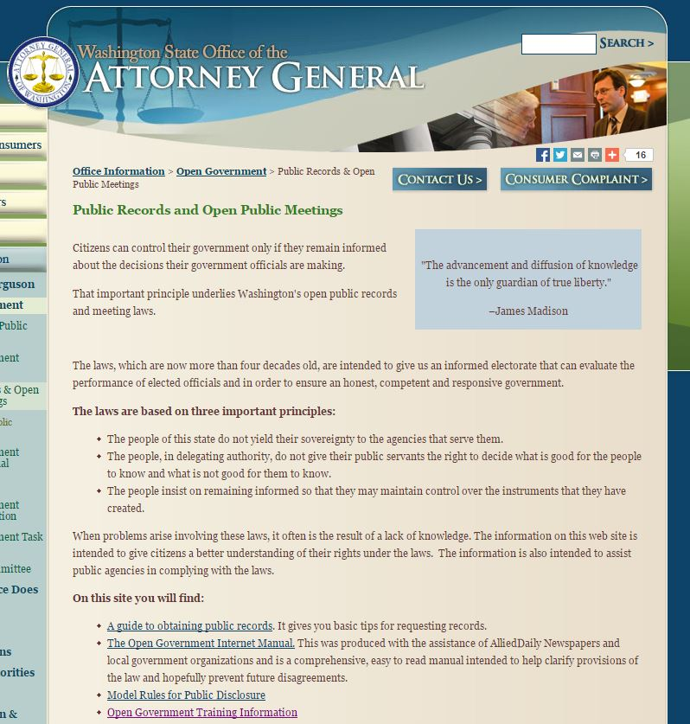
Online Tutorial:
http://www.atg.wa.gov/OpenGovernmentTraining.aspx

Slide 12
Key Concept:
Records As Public Property
RCW 40.14: The Public Records Act
Responsibilities and Authority of the Washington State Archives
Government records are public property
Officials / Employees pass records on to successors
Agencies must account for the disposition of records

Slide 13
Key Concept: Records Disposition Authority
RCW 40.14.060: State Records Committee
State agencies must establish legal authority to dispose of records
The State Records Committee grants disposition authority
Members: State Archives, State Auditor, Attorney General & OFM

Slide 14
Key Concept: State Agency
Records Officers
AND
Records Coordinators
Do you know your Agency Records Officer?
If not, ASK US at recordsmanagement@sos.wa.gov

Slide 15
Key Concept: Records Disposition Authority
RCW 40.14.070: Local Records Committee
State Archives Responsibilities and Authorities
Agencies must establish legal authority to dispose of records
The Local Records Committee grants disposition authority
Members: State Archives, State Auditor & Attorney General

Slide 16
Key Terms:
Records Retention Schedule
Records Series
Retention Period
Disposition Authority Number

Slide 17
What do Agencies do with Non-Archival Records?
Retain for the minimum retention; THEN
Destroy.
BUT:
A litigation hold or an public records request effectively stops disposal
The retention clock STOPS at that time, resumes only when hold removed or the request is resolved
Effective communication must be done at the time of the hold to prevent risk of spoilation (Intel – March 2007)

Slide 18
What do Agencies do with Archival Records?
Archival records must NOT be destroyed.
Agencies must either:
Keep the records themselves indefinitely; OR
Arrange with Washington State Archives for appraisal/transfer (at no cost).

Slide 19
Which Records Retention Schedule do I Use?
Local Government Agencies use both:
Local Government Common Records Retention Schedule (CORE);
AND
Sector-specific records retention schedules.
www.sos.wa.gov/archives

Slide 20
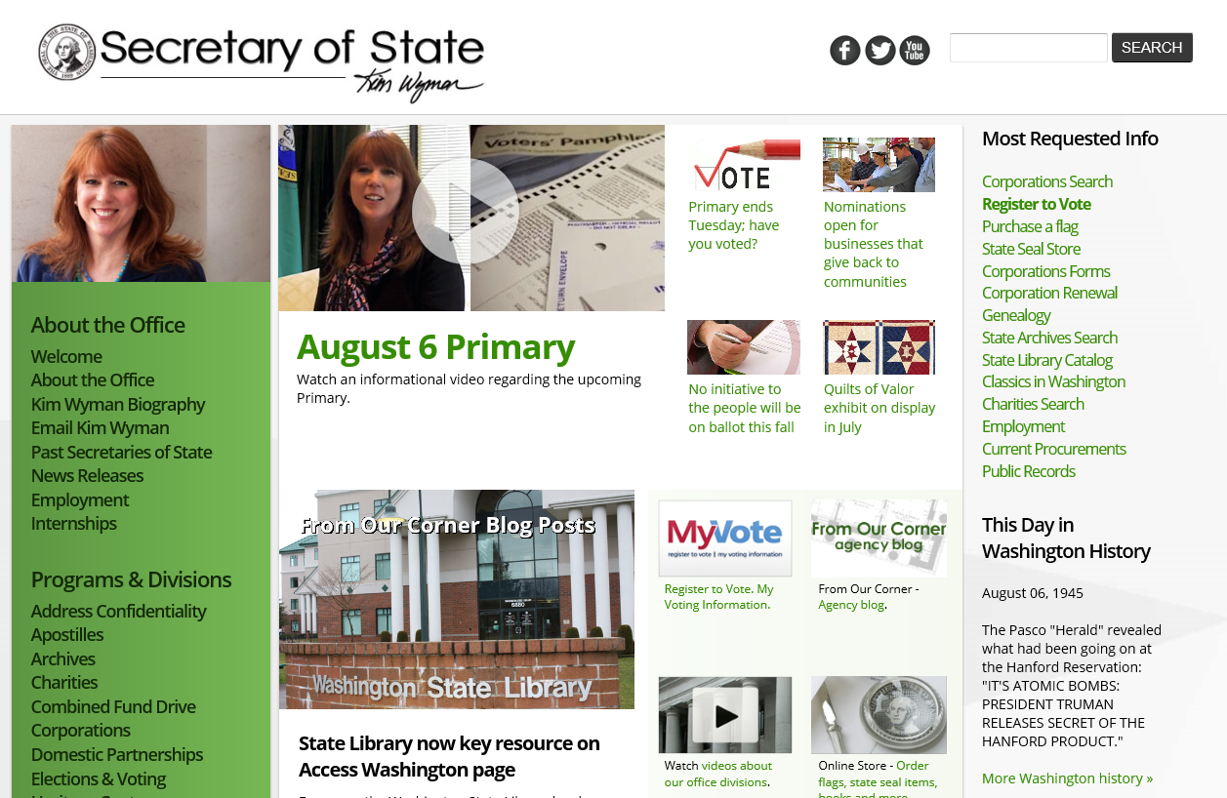
http://www.sos.wa.gov

Slide 21
http://www.sos.wa.gov/archives

Slide 22
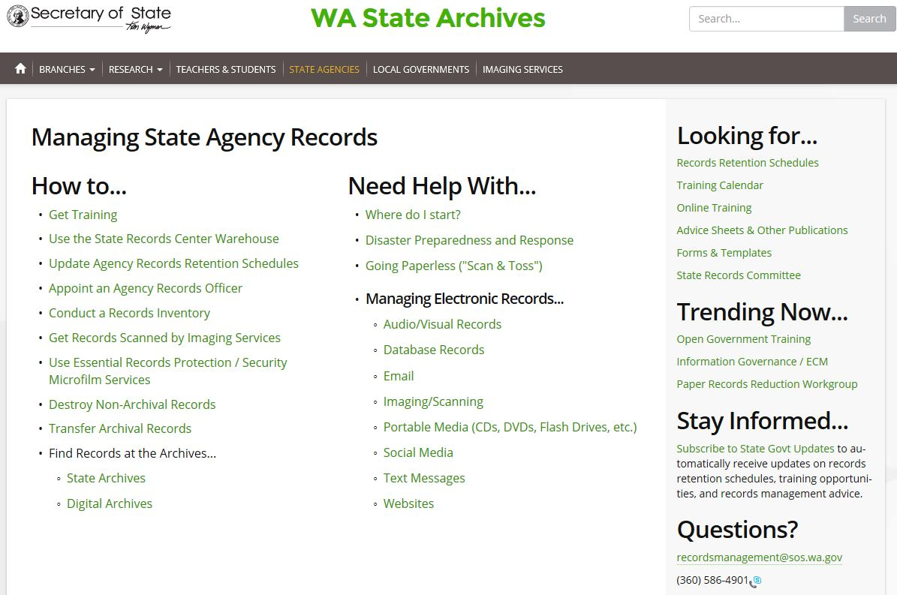
http://www.sos.wa.gov/archives/recordsmanagement/Managing-State-Agency-Records.aspx

Slide 23
http://www.sos.wa.gov/archives

Slide 24
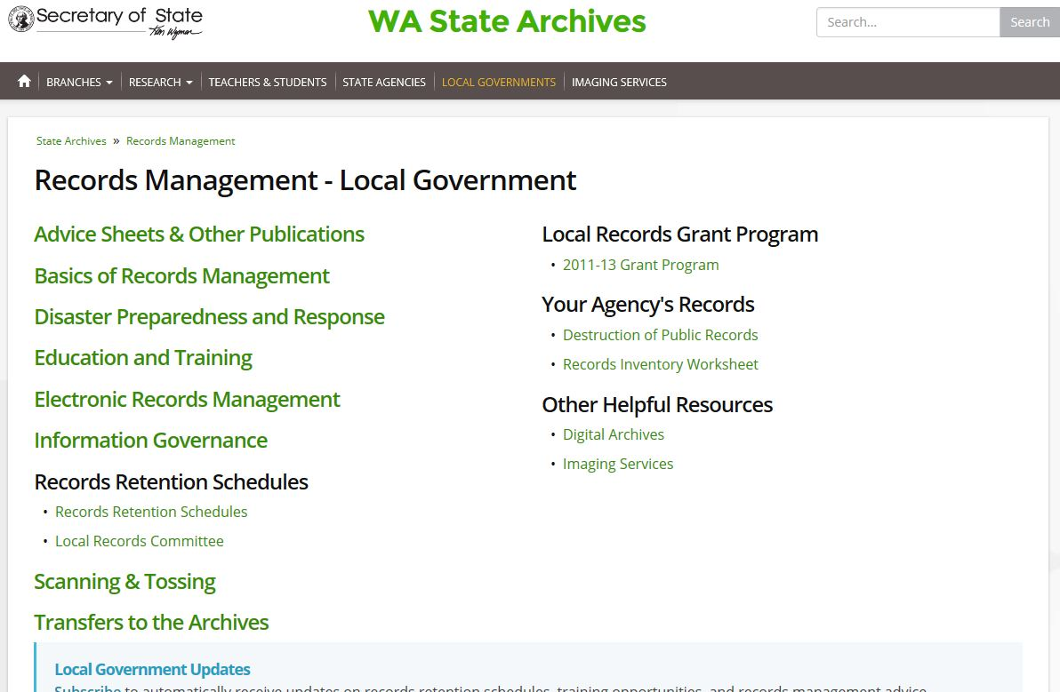
http://www.sos.wa.gov/archives/recordsmanagement/records_local.aspx

Slide 26
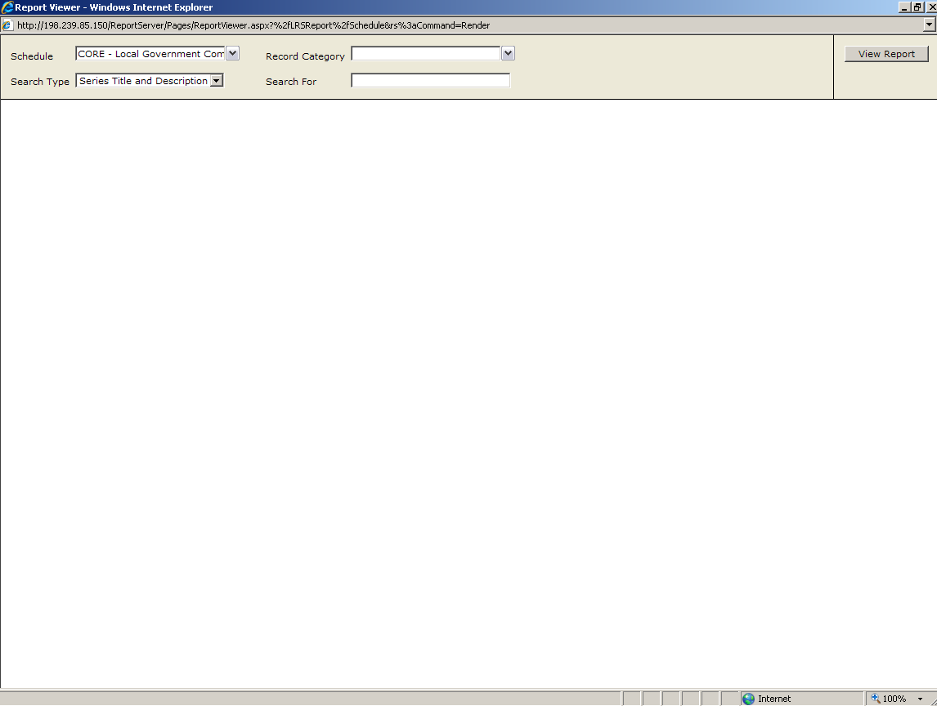
Database

Slide 27
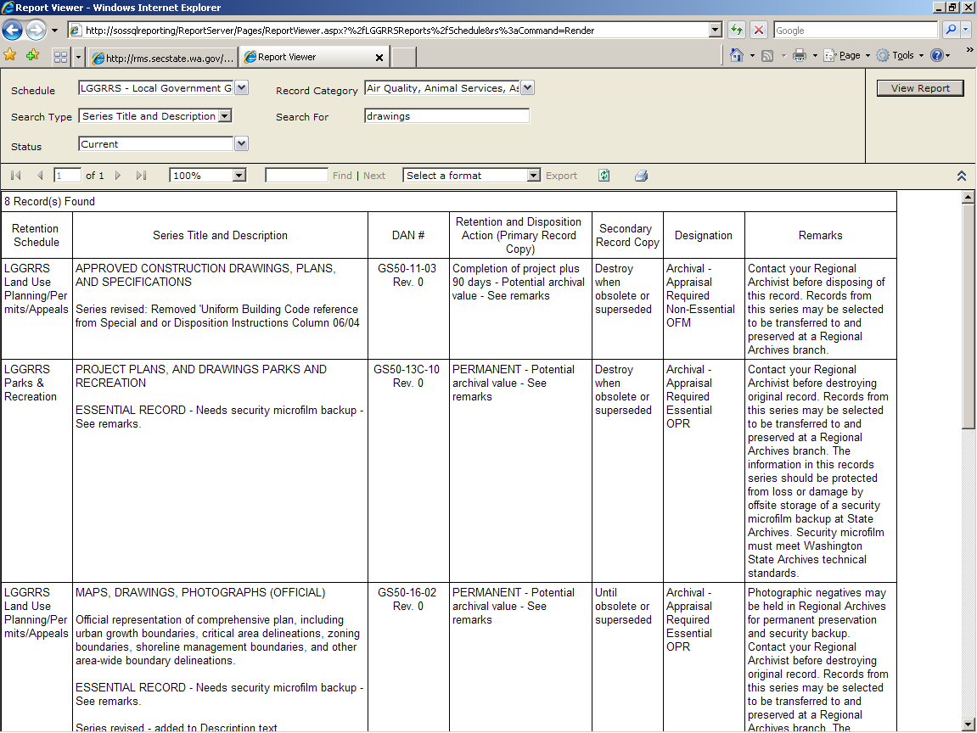

Slide 29
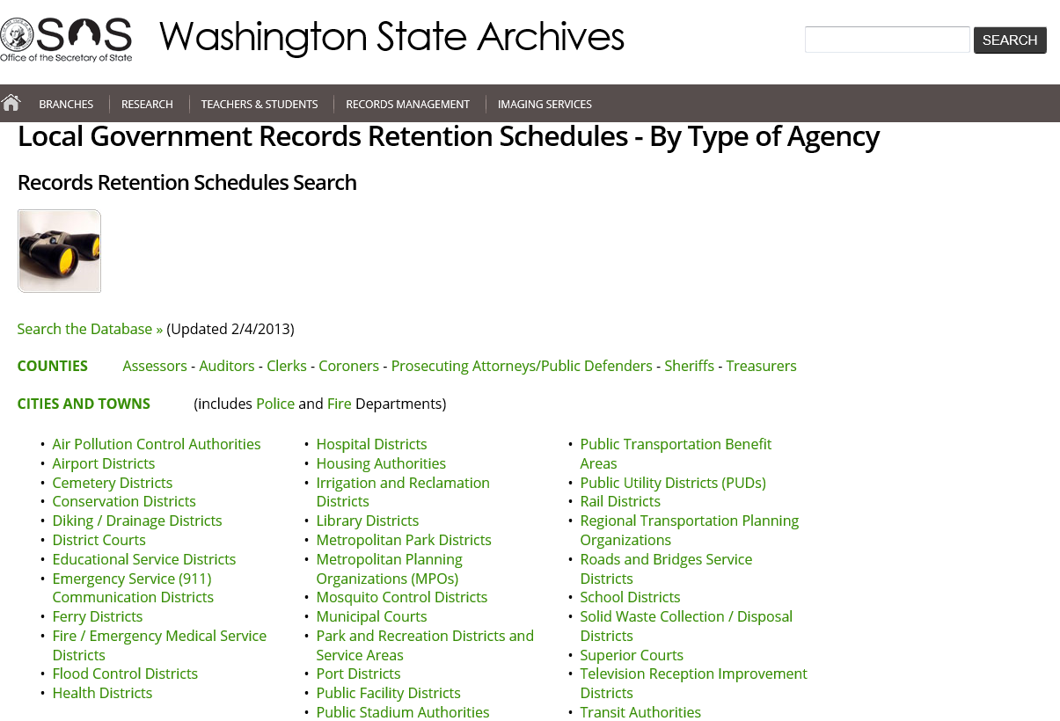

Slide 30
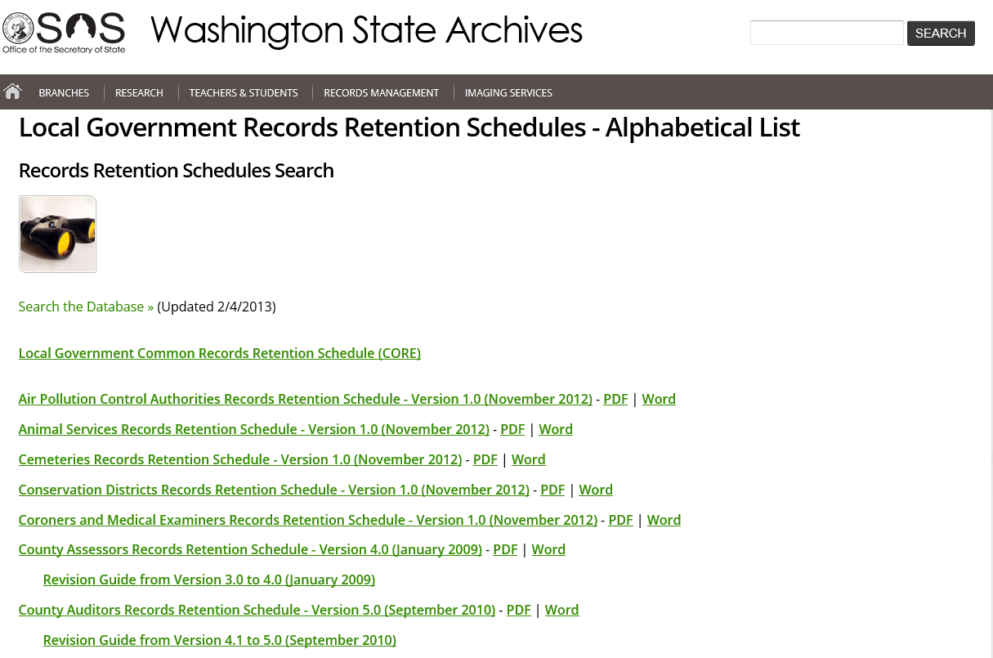

Slide 31
Break

Slide 32
Local Government Common
Records Retention Schedule (CORE)
Agency Management 1.1 Administration (General) 1.2 Authorization/Certification 1.3 Charter, Jurisdiction, and Mission 1.4 Community Relations 1.5 Contracts / Agreements 1.6 Elections (Elected Officials, Initiatives and Referenda) 1.7 Emergency Planning, Response and Recovery 1.8 Legal Affairs 1.9 Local Government Legislation 1.10 Meetings and Hearings 1.11 Planning 1.12 Policies & Procedures 1.13 Reporting 1.14 Risk Management / Insurance 1.15 Training

Slide 33
Local Government Common
Records Retention Schedule (CORE)
Asset Management 2.1 Acquisition/Ownership 2.2 Authorization/Certification 2.3 Construction 2.4 Disposal 2.4 Electronic Information Systems 2.5 Hazardous Materials Management 2.6 Inspection/Monitoring 2.7 Inventory 2.8 Maintenance 2.9 Planning 2.10 Reporting 2.11 Security 2.12 Usage and Operations

Slide 34
Local Government Common
Records Retention Schedule (CORE)
3. Financial Management 3.1 Accounting 3.2 Auditing 3.3 Authorization/Certification 3.4 Banking 3.5 Budget 3.6 Payroll 3.7 Planning 3.8 Purchasing 3.9 Reporting 3.10 Taxes

Slide 35
Local Government Common
Records Retention Schedule (CORE)
4. Human Resource Management 4.1 Authorization/Certification 4.2 Benefits 4.3 Equity 4.4 Industrial Insurance 4.5 Labor Relations 4.6 Misconduct / Discipline / Grievances 4.7 Occupational Health and Safety 4.8 Performance Management 4.9 Personnel 4.10 Position Development / Staff Structure 4.11 Recruitment / Hiring 4.12 Reporting 4.13 Staff Development

Slide 36
Local Government Common
Records Retention Schedule (CORE)
5. Information Management 5.1 Forms and Publications 5.2 Library Services 5.3 Mail Services 5.4 Public Disclosure 5.5 Records Conversion 5.6 Records Management

Slide 37
Local Government Common
Records Retention Schedule (CORE)
6. Records With Minimal Retention Value
6.1.1 Agency Information – Routine
6.1.2 Agency-Generated Forms & Publications - Copies
6.1.3 General Information – External
6.1.4 Secondary Copies
6.1.5 Transitory Records

Slide 38
Sector Schedules:
Air Pollution Control Authorities
Animal Services
Cemeteries
Conservation Districts
Coroners and Medical Examiners
County Assessors
County Auditors
County Clerks
County Treasurers

Slide 39
Sector Schedules:
10. District and Municipal Courts
11. Economic Development and Transport (including Ports)
12. Emergency Communications (911)
13. Fire and Emergency Medical
14. Housing Authorities
15. Land Use Planning and Permitting
16. Law Enforcement
17. Licensing, Permitting and Taxation

Slide 40
Sector Schedules:
18. Parks, Recreation and Culture
19. Prosecuting Attorneys
20. Public Health Departments and Districts
21. Public Hospital Districts
22. School Districts and ESDs
23. Social Services
24. Transit Authorities
25. Utility Services
26. Weed and Pest Control Districts

Slide 41
Putting Retention
Into Practice

Slide 42
Get rid of what you don’t need!
Much of what crosses our desks and our screens has little to no retention value.
Apply “Records with Minimal Retention Value” (GS50-02) to:
Informational materials
Secondary copies;
Transitory records.

Slide 43
Organize to Destroy
Up to 98% of records are non-archival.
These records will need to be destroyed someday.
It is more efficient (and therefore cheaper) to organize now rather than putting it off.

Slide 44
Destroying Non-Archival Records
Destroy non-archival records on a REGULAR annual basis.
Destroy non-archival records at end of their minimum retention period.
Document destruction of public records:
Work with your Agency’s Records Manager

Slide 45
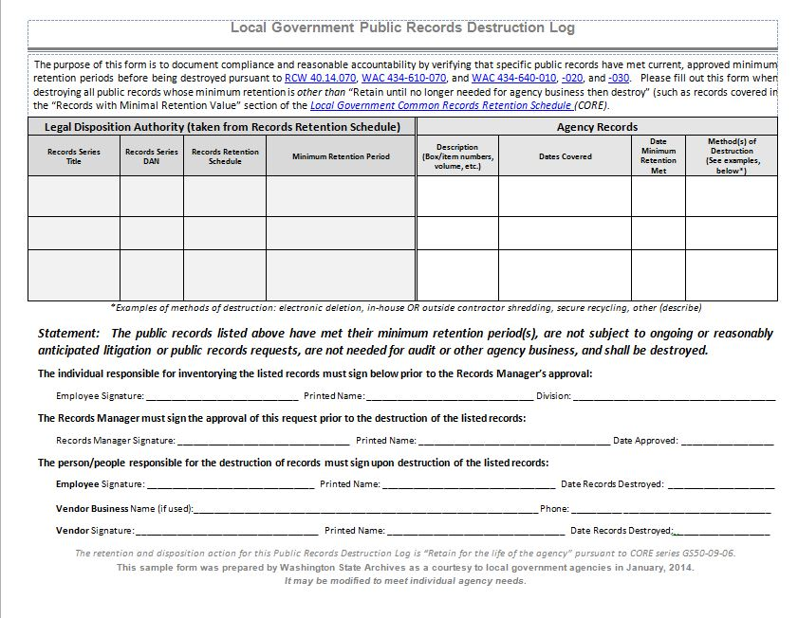
Model Records Destruction Log
Download at:
http://www.sos.wa.gov/archives/RecordsManagement/Destruction-of-Public-Records.aspx

Slide 46
Key Concept:
Secure Records Destruction
WAC 434-640-030 Disposal by recycling. Pursuant to disposal authorization from the state or local records committee, an agency may dispose of records by recycling, under the following conditions:
The prompt destruction shall be insured and the responsibility rests with the agency.
The recycling agent or entity shall have required licenses and shall be insured or bonded.
Records shall not be kept in unattended and unprotected storage.
The agency shall have a contract or agreement with the recycler that includes these conditions.

Slide 47
Transfer Archival Records
Key Concept:
Is your agency achieving it’s mission by using resources to preserve and provide access to records indefinitely?
Washington State Archives exists to do this on your behalf & save you money.
Records are preserved and still accessible.
Develop a regular transfer cycle for ongoing archival records (such as minutes, ordinances, etc).

Slide 48
In Summary…
Agencies need to:
Retain all public records for at least the minimum retention period as listed on the approved Records Retention Schedule.
Destroy non-archival records at the end of their retention period.
Continue to retain, or transfer to Washington State Archives, all archival records.

Slide 49
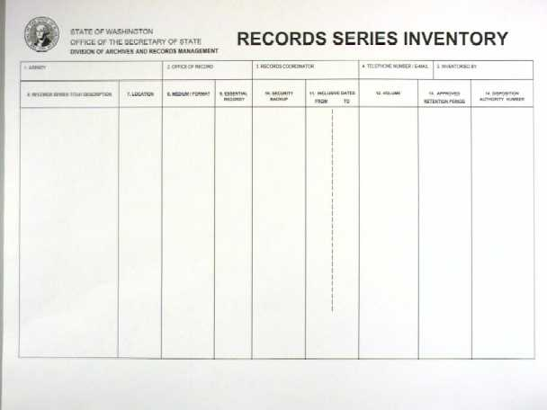
Key Concept:
Inventory Your Records Series
Sample Records Series Inventory Form

Slide 50
Records Series Inventory Information
Records Series Title and Description
Location
Medium
Essential Record?
Inclusive Dates
Volume
Approved Retention Period
Potential Archival Value?
Disposition Authority Number

Slide 51
Key Concept:
Public Access to Government Records
RCW 42.56: Public Disclosure Act
Defines rights of public access
Emphasizes rights of public access
Exemptions from disclosure
Duty to protect records security
http://www.atg.wa.gov/records/modelrules/index.shtml
http://www.mrsc.org/Publications/pra06.pdf

Slide 52
Public Disclosure Survival Skill #1
Know your Business -
Know your Records

Slide 53
Public Disclosure Survival Skill #2
Establish a records management function in your agency

Slide 54
Public Disclosure Survival Skill #3
Get rid of what
you don’t need

Slide 55
Public Disclosure Survival Skill #4
Transfer Archival Records to
Washington State Archives

Slide 56
Public Disclosure Survival Skill #5
Organize and Manage
Electronic Records

Slide 57
Public Disclosure Survival Skill #6
Convert
High-Demand Records
to Digital Images

Slide 58
RESOURCES
Assistant Attorney General for Open Government Nancy Krier NancyK1@atg.wa.gov (360) 586-7842
Municipal Research & Services Corp.
www.mrsc.org (206) 625-1300
Model Rules on Public Disclosure
http://www.atg.wa.gov/OpenGovernment/ModelRules.aspx#.U6iRTBHn_cs
Local Government General Records Retention Schedules
http://www.sos.wa.gov/archives/RecordsRetentionSchedules.aspx

Slide 59
Key Concept:
Division of Archives and Records Management
Services To Local Government Agencies
Public Records Management
Imaging
Regional Archives
Digital Archives

Slide 60
Records Management Services
General Records Retention Schedules
Records Management Manuals
Records Management Training
Local Records Committee Staff Support
Records Management Advice & Assistance

Slide 61
Imaging Services
Security Microfilm Inspection & Storage (Free of Charge)
Source Document Scanning (Fee for Service)
Source Document Microfilming (Fee for Service)
Output of Digital Records Information to Microfilm (Fee for Service)
Microfilm Scanning (Fee for Service)
Direct Microfilm Duplication (Fee for Service)
For Further Information Contact:
Patrick Williams
Washington State Archives
PO Box 40238
Olympia, WA 98504-0238
Telephone – 360-586-0108
E-mail – patrick.williams@sos.wa.gov

Slide 62
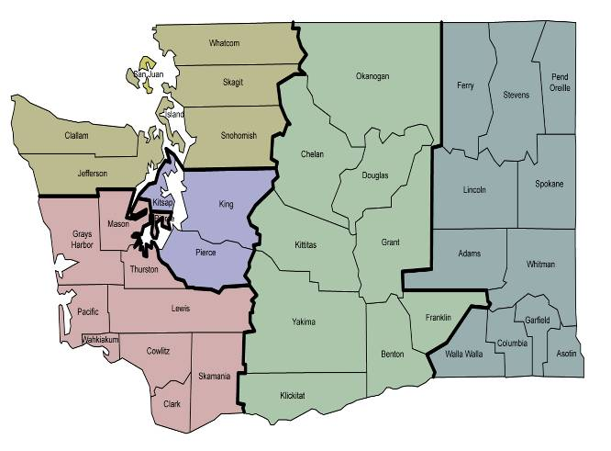
Regional Archives System
Mission: Preserve archival records for public use and serve as the focal points for services to local government.
Vision: Build a world class system to promote public records management and preserve historically valuable records for public research use.

Slide 63
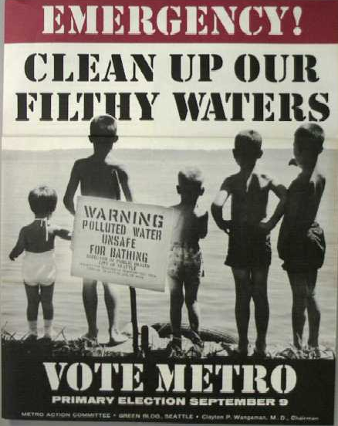
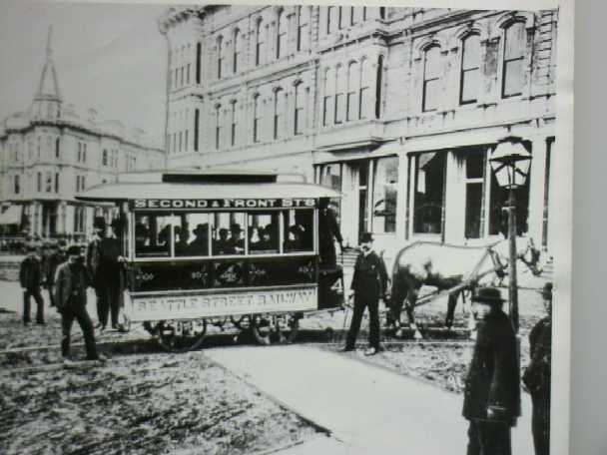
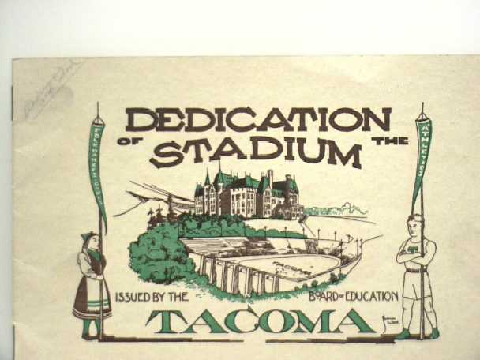
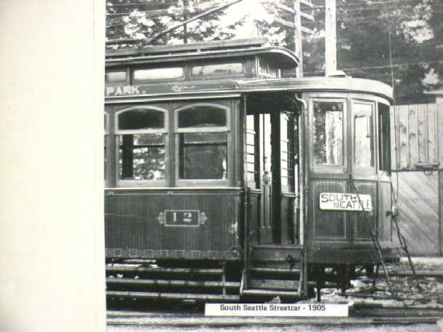
Archival Services
Appraisal and Transfer
Arrangement , Description and Preservation
Public Research Access

Slide 64
Stay Informed
Online

Slide 65
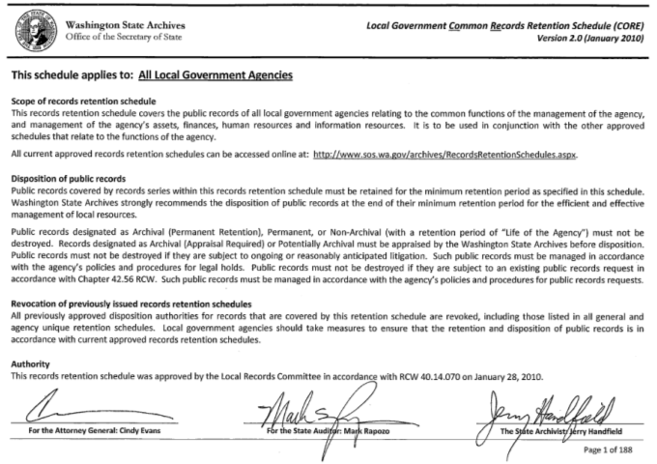
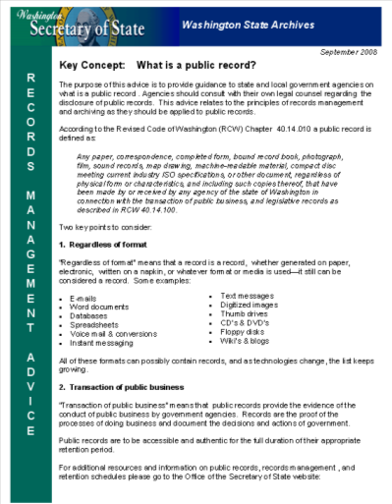
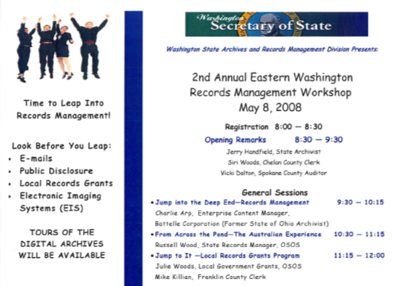
Advice, Training, Updates

Slide 66
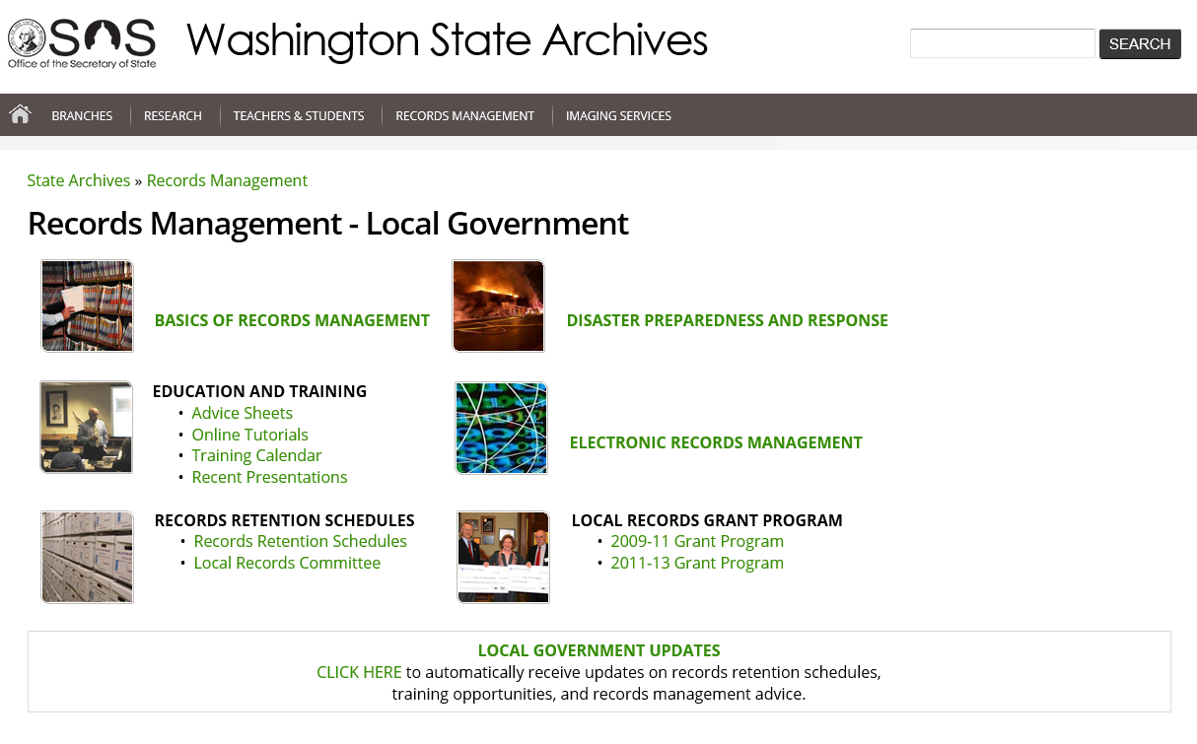
Training Calendar

Slide 67
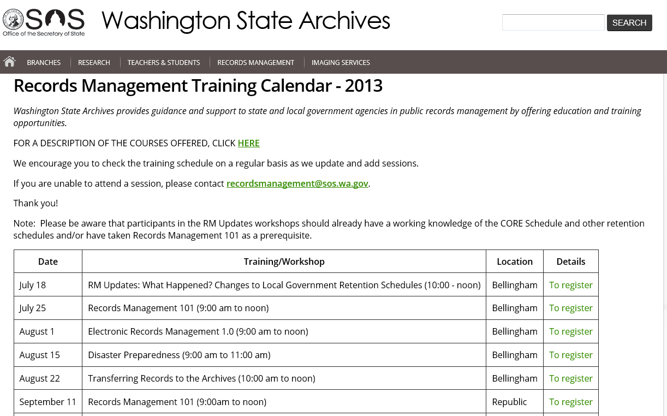
Training, Classes, Workshops

Slide 68
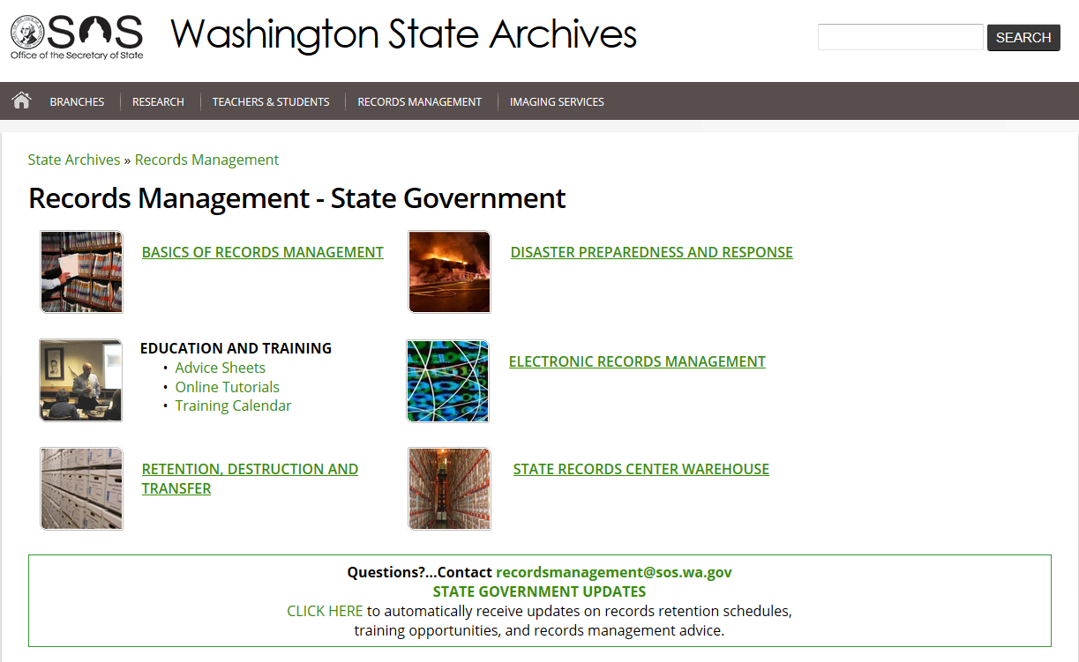
State Government Updates Listserv

Slide 69
Local Government Updates Listserv

Slide 70
You Are Not Alone!
For advice and assistance:
recordsmanagement@sos.wa.gov
Check out our other online tools at
http://www.sos.wa.gov/archives/RecordsManagement/

